Slide 1


Gesturescape
Crafting Home Harmony

Slide 2


About us
Nipun Meegoda
Team Leader
Undergraduate - B.Sc (Hons) Computer Science (SLIIT)

Slide 3

About us
Ometh Aberathne
Team Member
Undergraduate - B.Sc (Hons) Computer Science (SLIIT)

Slide 4
About us
Dinethmin Uduwilaarachchi
Team Member
Undergraduate - B.Sc (Hons) Computer Science (SLIIT)

Slide 5

About us
Amasha Munasinghe
Team Member
Undergraduate - B.Sc (Hons) Computer Science (SLIIT)

Slide 6
Table of Content
Introduction
Objectives
Literature
Methodology
Testing and Evaluation
Timeline
Budget

Slide 7
Introduction

Slide 8
Introduction
A smart home system that integrates gesture, voice, and sound controls

Slide 9
Introduction
Hands-free and convenient way of controlling home appliances

Slide 10
The Objective

Slide 11
The Objective
Design and implement a functional smart home system
that responds to,
Gestures
Voice Commands
Sound Inputs

Slide 12
Sub Objectives
Software Developing / Gesture Control
Hardware / Communication
User Experience / Voice Control
Hardware and Integration

Slide 13
Software Developing / Gesture Control
Will be developed by Ometh Aberathne
Research existing gesture recognition algorithms and techniques.
Develop and optimize gesture recognition algorithms for the system.
Implement gesture-based control for lighting and fan devices.
</>

Slide 14

Hardware / Communication
Will be developed by Amasha Munasinghe
Study wireless communication protocols for integrating the base station and Arduino remote.
Implement Bluetooth communication between the base station and Arduino UNO.
Design and build the hardware interface for device control using relays.

Slide 15
User Experience / Voice Control
Will be developed by Nipun Meegoda
Analyse user interaction patterns and accessibility requirements.
Implement voice recognition using the Google speech recognition module.
Design the user interface for voice commands and system settings.
UX

Slide 16

Hardware and Integration
Will be developed by Dinethmin Uduwalaarachchi
Work on the mechanical aspects of the system's integration.
Assist in physical setup and testing of the hardware components.
Ensure that all hardware components are securely integrated.

Slide 17
Literature

Slide 18

Literature
Research will be conducted on,
Existing smart home systems
Gesture recognition techniques
Voice recognition modules
Design principles

Slide 19
Methodology

Slide 20
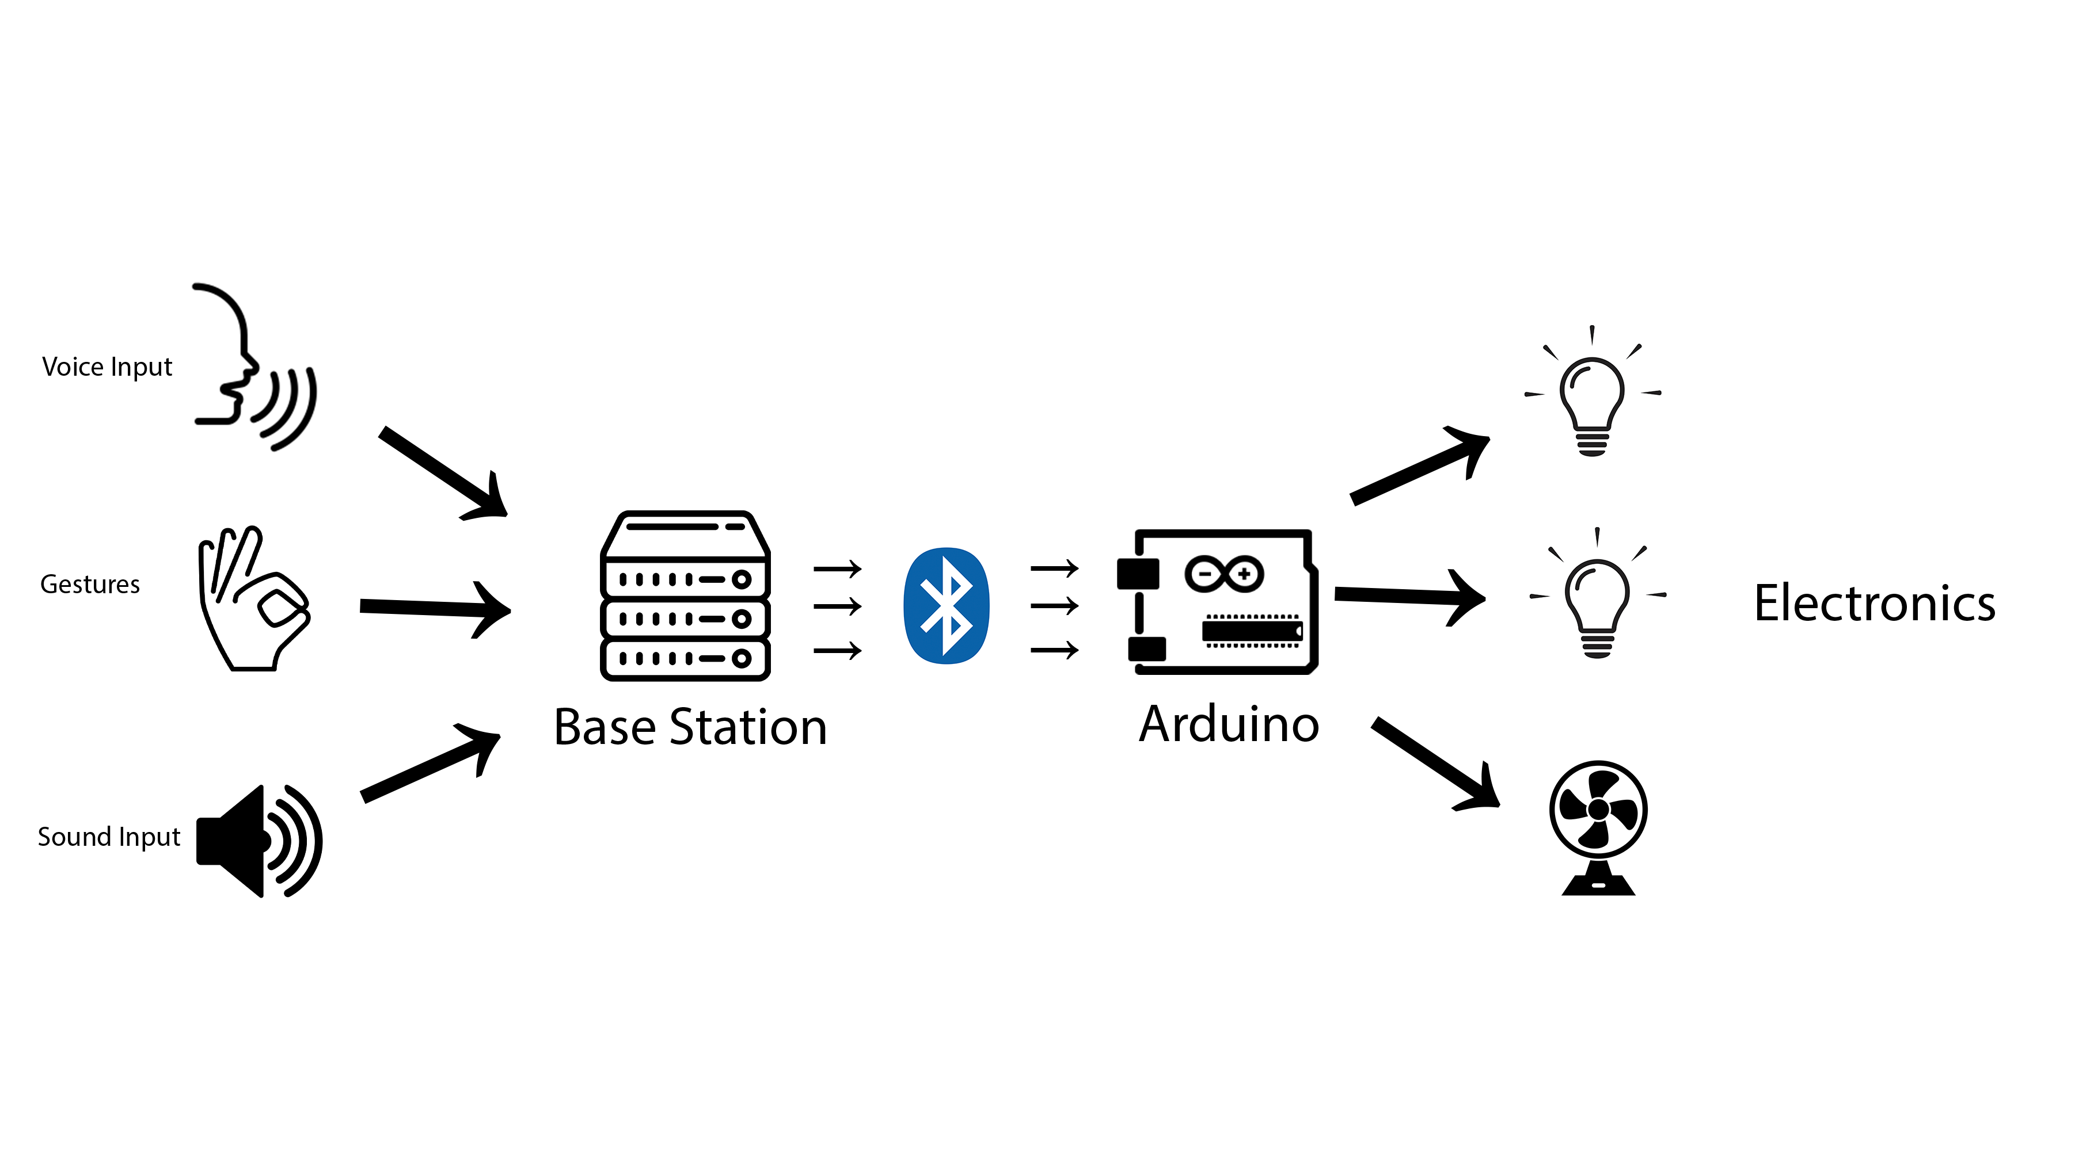
Methodology

Slide 21
Testing and Evaluation

Slide 22
Testing and Evaluation
The device will be evaluated through
user testing
performance analysis
Accuracy of gesture and voice recognition will be measured through controlled scenarios

Slide 23
Timeline

Slide 24
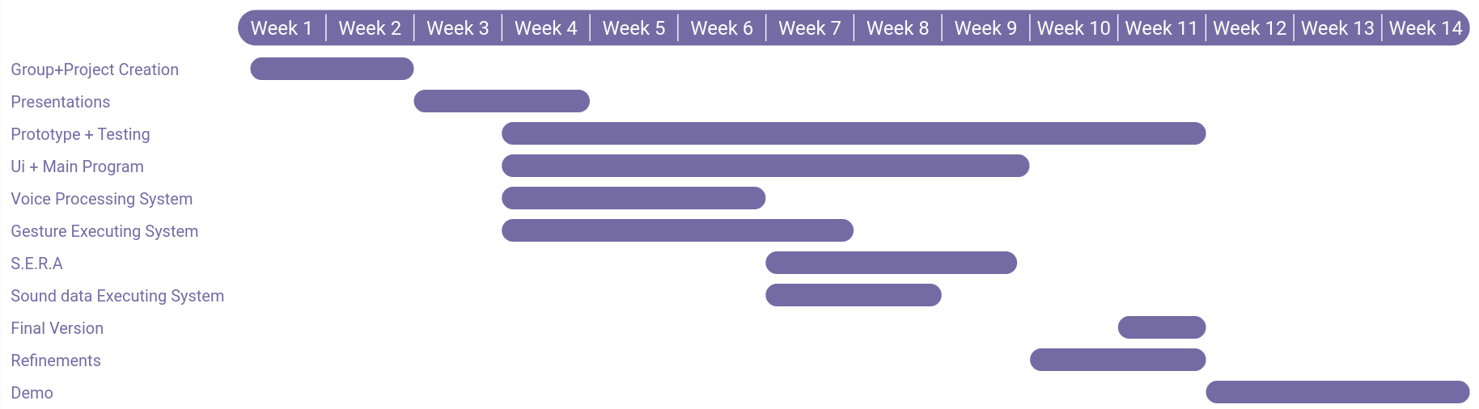
Timeline

Slide 25
Budget

Slide 26
Budget

Slide 27

It’s Time for Q & A

Slide 28

Thank you !

